Slide 1
Brain electrical grids and computing grids:
A perfect match
Mike X Cohen

Slide 2
The brain

Slide 3
The behavior
GREEN

Slide 4
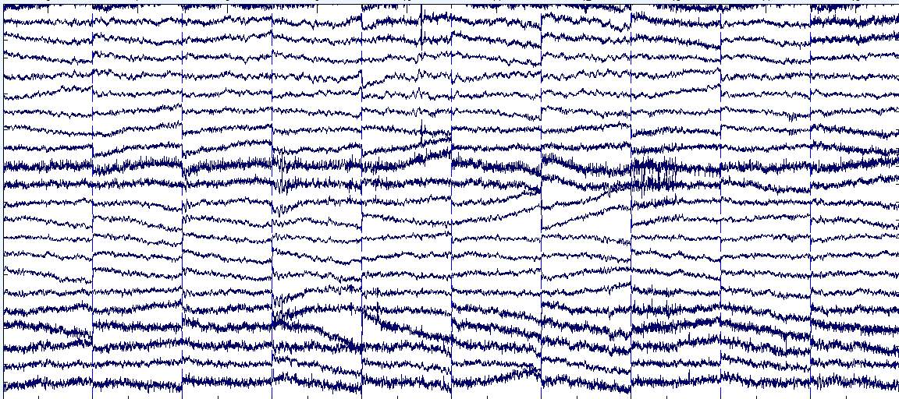
Brain electrical activity

Slide 5
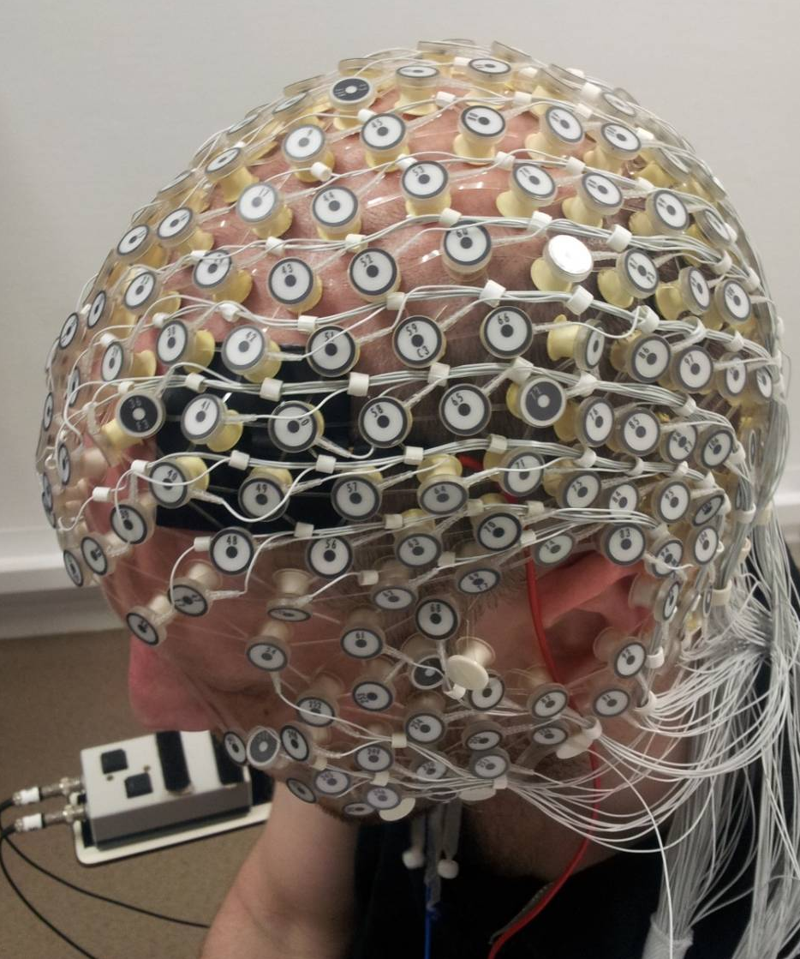
Cutting-edge EEG recording technology
256 electrodes
1 kHz sampling
~5 GB/hour

Slide 6
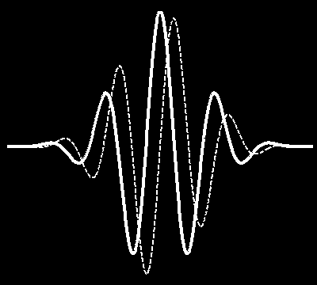
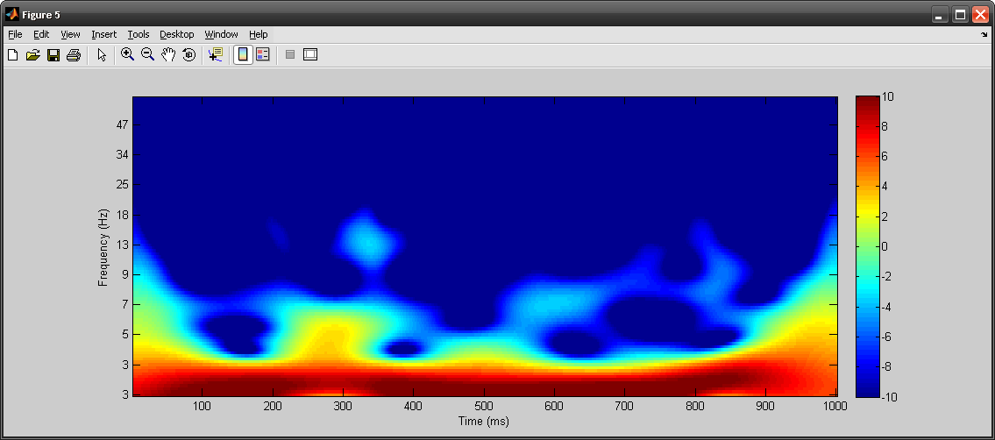
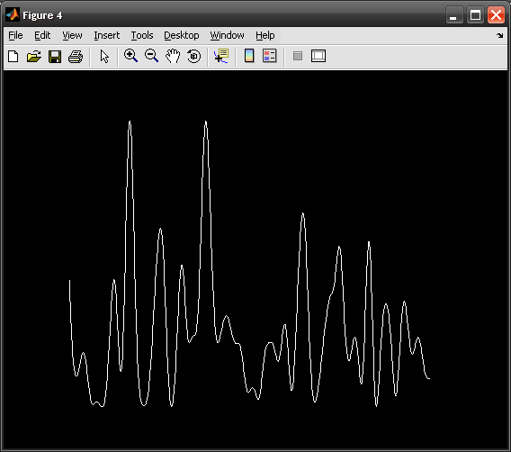
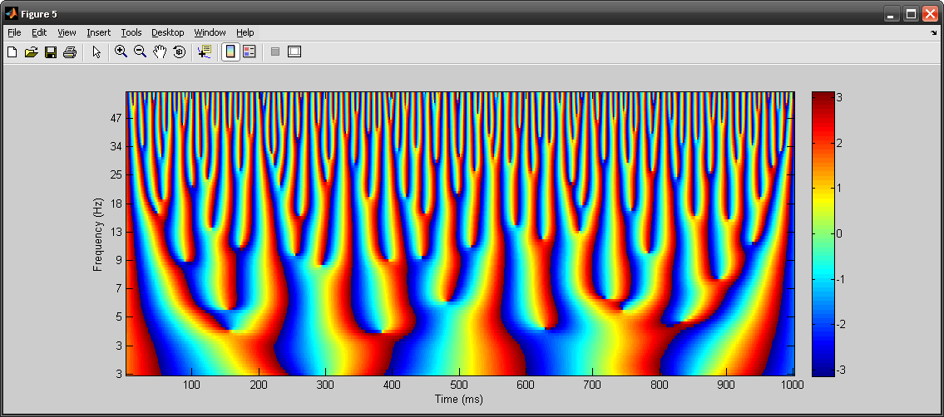
Data dimension explosion
imag
.
m
*
α
θ
real
real
Magnitude (α)
Phase angle (θ)

Slide 7
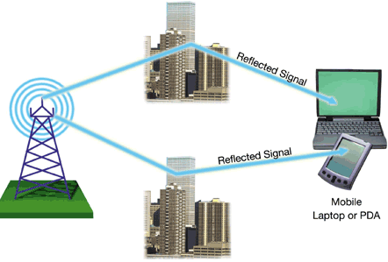
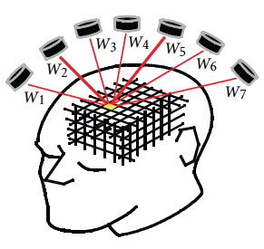
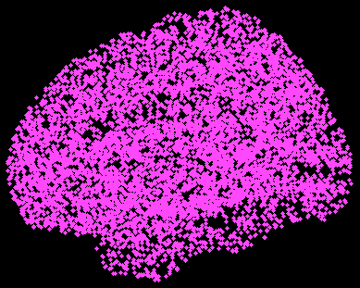
Beamforming for source localization
21437174

Slide 8
Why we need computational power
Data dimensions:
Space (spherical or 3D)
Time
Frequency (power vs. phase)
Experiment condition
Connectivity
Subjects

Slide 9
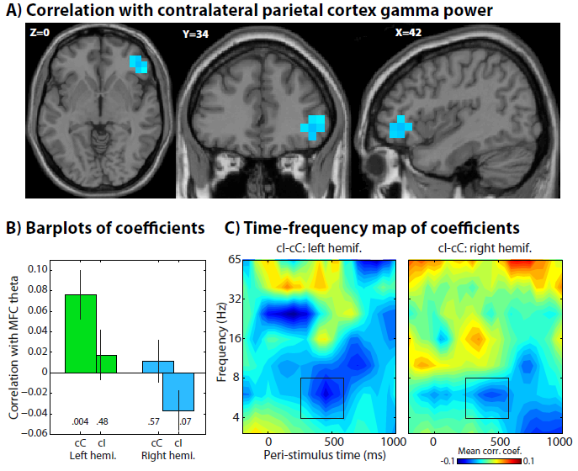
Example of typical results

Slide 10
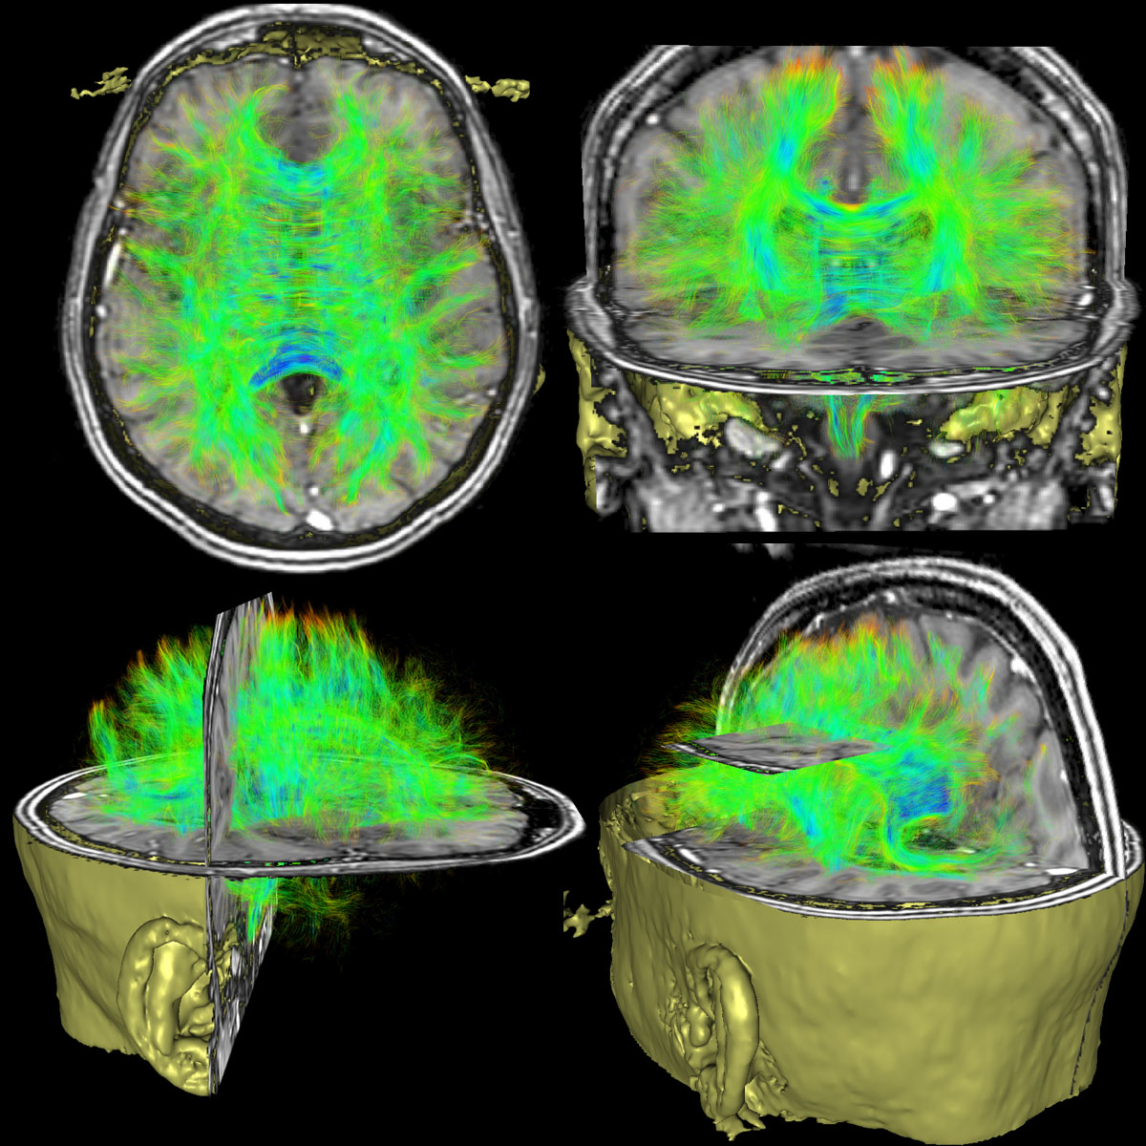
It gets worse:
Anatomical connectivity is also important.

Slide 11
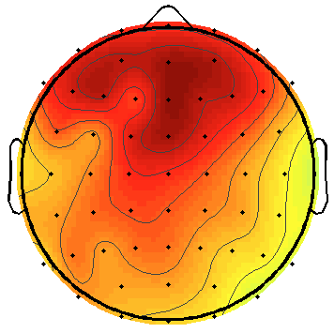
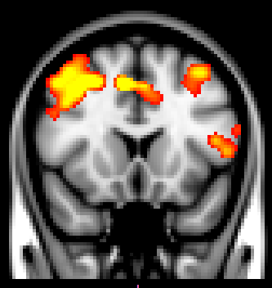
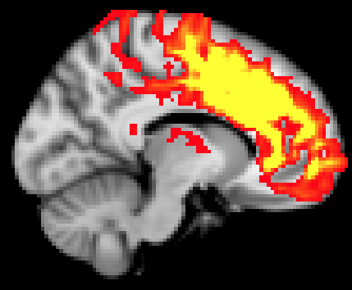
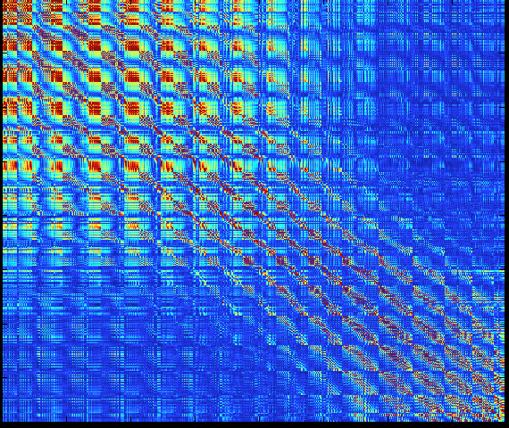
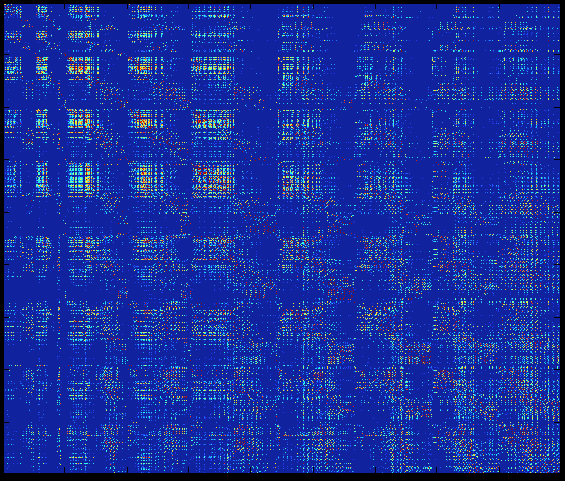
Linking anatomical and functional connectivity
EEG single-trial power
MNE conflict effect
Seeded tractography
EEG connectivity matrix
DTI connectivity matrix
Voxels
Voxels
Voxels
Voxels

Slide 12
The problem:
Brain data analyses involve many repeated transformations of very large data matrices.
Standard computers cannot handle these analyses without annoying interventions.

Slide 13
The solution:
A scalable, dynamic, and remotely accessible grid of processors.

Slide 14
*Note: open to collaborations starting in 2013!

